Slide 1

Problem Solving?

Slide 2
Problem Solving?
Let say you are A and your friend is B (who is always willing to help you).

Slide 3
Problem Solving?
Let say you are A and your friend is B (who is always willing to help you).
A : I want off, just for somedays, but …

Slide 4
Problem Solving?
Let say you are A and your friend is B (who is always willing to help you).
A : I want off, just for somedays, but …
B : but what? go buddy, enjoy !!

Slide 5
Problem Solving?
Let say you are A and your friend is B (who is always willing to help you).
A : I want off, just for somedays, but …
B : but what? go buddy, enjoy !!
A : Some one have to do my job in my absence !

Slide 6
Problem Solving?
Let say you are A and your friend is B (who is always willing to help you).
A : I want off, just for somedays, but …
B : but what? go buddy, enjoy !!
A : Some one have to do my job in my absence !
B : That’s it? I am available, as always.

Slide 7
Problem Solving?
Let say you are A and your friend is B (who is always willing to help you).
A : I want off, just for somedays, but …
B : but what? go buddy, enjoy !!
A : Some one have to do my job in my absence !
B : That’s it? I am available, as always.
A : Great, you are a true friend. Ok I am leaving,

Slide 8
Problem Solving?
Let say you are A and your friend is B (who is always willing to help you).
A : I want off, just for somedays, but …
B : but what? go buddy, enjoy !!
A : Some one have to do my job in my absence !
B : That’s it? I am available, as always.
A : Great, you are a true friend. Ok I am leaving,
B : Hey, wait, what do I have to do? What’s your job?

Slide 9
Problem Solving?
Let say you are A and your friend is B (who is always willing to help you).
A : I want off, just for somedays, but …
B : but what? go buddy, enjoy !!
A : Some one have to do my job in my absence !
B : That’s it? I am available, as always.
A : Great, you are a true friend. Ok I am leaving,
B : Hey, wait, what do I have to do? What’s your job?
A : After every 8 hours, pick the email of the costumer with maximum sales.

Slide 10
Problem Solving?
Let say you are A and your friend is B (who is always willing to help you).
A : I want off, just for somedays, but …
B : but what? go buddy, enjoy !!
A : Some one have to do my job in my absence !
B : That’s it? I am available, as always.
A : Great, you are a true friend. Ok I am leaving,
B : Hey, wait, what do I have to do? What’s your job?
A : After every 8 hours, pick the email of the costumer with maximum sales.
B : Ok, from where?

Slide 11
Problem Solving?
Let say you are A and your friend is B (who is always willing to help you).
A : I want off, just for somedays, but …
B : but what? go buddy, enjoy !!
A : Some one have to do my job in my absence !
B : That’s it? I am available, as always.
A : Great, you are a true friend. Ok I am leaving,
B : Hey, wait, what do I have to do? What’s your job?
A : After every 8 hours, pick the email of the costumer with maximum sales.
B : Ok, from where?
A : From the sales records

Slide 12
Problem Solving?
Let say you are A and your friend is B (who is always willing to help you).
A : I want off, just for somedays, but …
B : but what? go buddy, enjoy !!
A : Some one have to do my job in my absence !
B : That’s it? I am available, as always.
A : Great, you are a true friend. Ok I am leaving,
B : Hey, wait, what do I have to do? What’s your job?
A : After every 8 hours, pick the email of the costumer with maximum sales.
B : Ok, from where?
A : From the sales records
B : Oh, ok, what should I do with the email that I have picked?

Slide 13
Problem Solving?
Let say you are A and your friend is B (who is always willing to help you).
A : I want off, just for somedays, but …
B : but what? go buddy, enjoy !!
A : Some one have to do my job in my absence !
B : That’s it? I am available, as always.
A : Great, you are a true friend. Ok I am leaving,
B : Hey, wait, what do I have to do? What’s your job?
A : After every 8 hours, pick the email of the costumer with maximum sales.
B : Ok, from where?
A : From the sales records
B : Oh, ok, what should I do with the email that I have picked?
A : Write it in priority records

Slide 14
Problem Solving?
Let say you are A and your friend is B (who is always willing to help you).
A : I want off, just for somedays, but …
B : but what? go buddy, enjoy !!
A : Some one have to do my job in my absence !
B : That’s it? I am available, as always.
A : Great, you are a true friend. Ok I am leaving,
B : Hey, wait, what do I have to do? What’s your job?
A : After every 8 hours, pick the email of the costumer with maximum sales.
B : Ok, from where?
A : From the sales records
B : Oh, ok, what should I do with the email that I have picked?
A : Write it in priority records
B : That’s it? That’s all your job?

Slide 15
Problem Solving?
Let say you are A and your friend is B (who is always willing to help you).
A : I want off, just for somedays, but …
B : but what? go buddy, enjoy !!
A : Some one have to do my job in my absence !
B : That’s it? I am available, as always.
A : Great, you are a true friend. Ok I am leaving,
B : Hey, wait, what do I have to do? What’s your job?
A : After every 8 hours, pick the email of the costumer with maximum sales.
B : Ok, from where?
A : From the sales records
B : Oh, ok, what should I do with the email that I have picked?
A : Write it in priority records
B : That’s it? That’s all your job?
A : (So relaxed) Yes.

Slide 16
Problem Solving?
A leaves and later that day, receives a call from B ( I don’t really know what to do… Can you tell me step by step what to do? I have sales records with me having all the records for the last 8 hours)

Slide 17
Problem Solving?
A leaves and later that day, receives a call from B ( I don’t really know what to do… Can you tell me step by step what to do? I have sales records with me having all the records for the last 8 hours)
A :
Start from the first record and focus just on sales column
Go to each next record and find the record with maximum sales
If there are more than 1 records with maximum sales then pick the first one from top to bottom and ignore the rest
Focus on the email column of the record you found in step 3
See the email address and write it in the priority records
Repeat steps 1-to-5 for every 8 hours

Slide 18
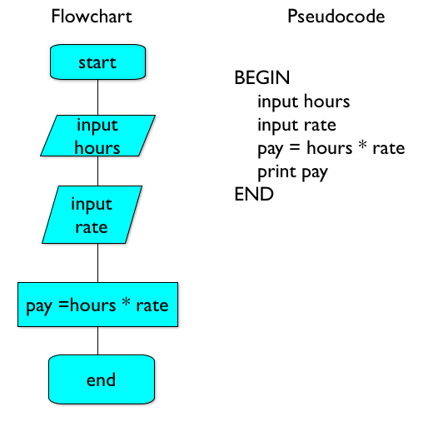
Problem Solving?

Slide 19
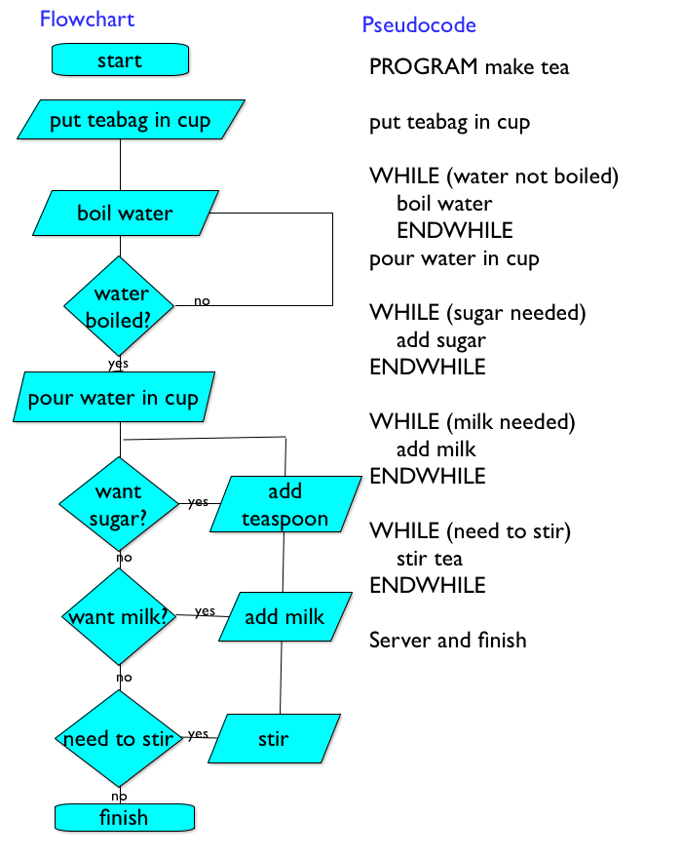
Problem Solving?

Slide 20
Problem Solving?
Search Minimum:
searchMinFromList(L,n)
minValue = L[1]
idx = 1
counter = 2
while (counter <= n)
v = L[counter]
if ( v < minValue )
minValue = v
idx = counter
else
pass
endIF
counter = counter+1
endWhile
return minValue , idx
endSearchMinFromList

Slide 21
Problem Solving?
Selection Sort
searchMinFromList(L,n)
minValue = L[1]
idx = 1
counter = 2
while (counter <= n)
v = L[counter]
if ( v < minValue )
minValue = v
idx = counter
else
pass
endIF
counter = counter+1
endWhile
return minValue , idx
endSearchMinFromList
sortList(L,n)
L2 = []
counter = 1
while (counter <= n)
min, idx = searchMinFromList (L , n)
insert in L2 = min
delete L[idx]
n = n - 1
endWhile
return L2
endSortList

Slide 22
Problem Solving Python
Selection Sort
def sortList(L,n):
L2 = []
counter = 0
while (counter < n):
m , idx = searchMinFromList (L , n)
L2.append(m)
del L[idx]
n = n-1
return L2
def searchMinFromList(L,n):
minValue = L[0]
counter = 1
while (counter < n):
v = L[counter]
if ( v < minValue ):
minValue = v
idx = counter
else:
pass
return minValue , idx

